Slide 1
The Keeping Quilt Written by Patricia Polacco
OCR 2000
Unit 4 Lesson 6
Gloria Garibay
Notes:
http://www.opencourtresources.com

Slide 2
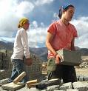
Hauling
Carrying or Transporting objects
Sentence pg: 74
Synonym: carrying; moving; conveying
Antonym: remain; stay; idle
Part of Speech: verb
Gloria Garibay

Slide 3
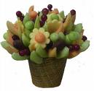
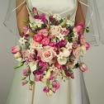
Bouquet
A bunch of flowers, cut and gathered together
Sentence pg: 77
Synonym: corsage; posy; nosegay
Antonym: potted flowers
Part of Speech: noun
Gloria Garibay

Slide 4
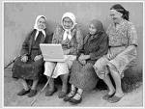
Babushka
An elderly Russian woman; or a woman’s triangular scarf used as a hood and tied under the chin.
Sentence pg: 75
Part of Speech: Noun
Gloria Garibay

Slide 5
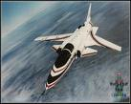
Artificial
Not natural; made by people, not by nature; fake
Sentence pg: 74
Synonym:counterfeit; false; unreal
Antonym: natural; genuine
Part of Speech: adjective
Gloria Garibay

Slide 6
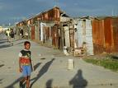
Poverty
Having little or no money, goods, or means to support oneself
Sentence pg: 76
Synonym: poor; hardship
Antonym: rich; wealth
Part of Speech: Noun
Gloria Garibay

Slide 7
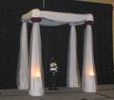
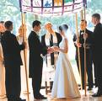
Huppa/Chuppa
A canopy used in a Jewish marriage ceremony made out of cloth or a prayer cloth.
Sentence pg: 76
Part of Speech: Noun
Gloria Garibay

Slide 8
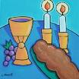
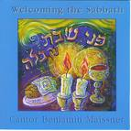
Sabbath
The 7th day of the week- Saturday - it is known as the day of rest and religious observance.
Sentence pg: 76
Synonym: Saturday
Part of Speech: Noun
Gloria Garibay

Slide 9
Challah
A loaf of rich white bread leavened with yeast and eggs, braided before baking.
Sentence pg: 76
Synonym: Hallah
Antonym: Rolls
Part of Speech: Noun
Gloria Garibay

