Slide 1
VOCABULARY WORDS - SEAL SURFER
Please go over the definitions for these vocabulary words with your student. There will be a test on them on Friday.
basked- rested in pleasant warmth
buffeted- struck against powerfully
horizon- the line where the sky seems to meet the earth
quay- a dock where ships are loaded and unloaded
surf- to ride on waves, often on a surfboard
swell- a long wave that moves along without breaking
swooped- moved with a sudden, sweeping motion

Slide 2
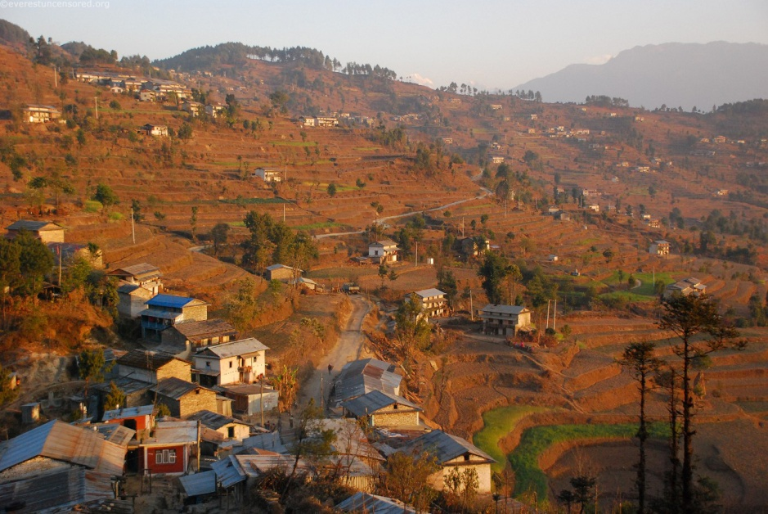
basked- rested in pleasant warmth
A sea turtle basked in the sun on a warm day.
The village of Deurali, Dolakha, Nepali basked in morning sunlight

Slide 3
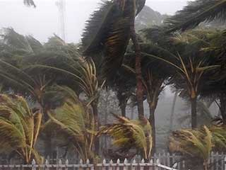
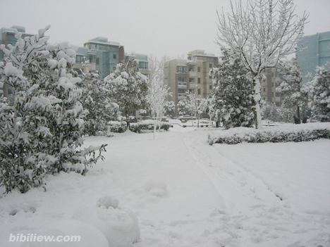
buffeted- struck against powerfully
A tropical storm buffeted the palm trees
Bahia Blanca, Argentina buffeted by one of the worst snow storms in 50 years
Shanghai buffeted by a snow storm

Slide 4
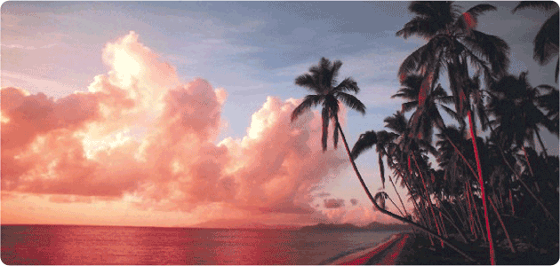
horizon- the line where the sky seems to meet the earth
Two beautiful Hawaiian horizons

Slide 5
quay- a dock where ships are loaded and unloaded
North Port quay concept

Slide 6
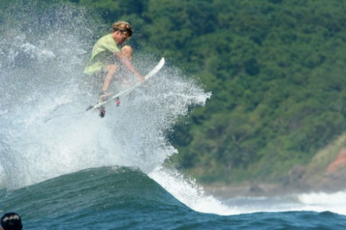
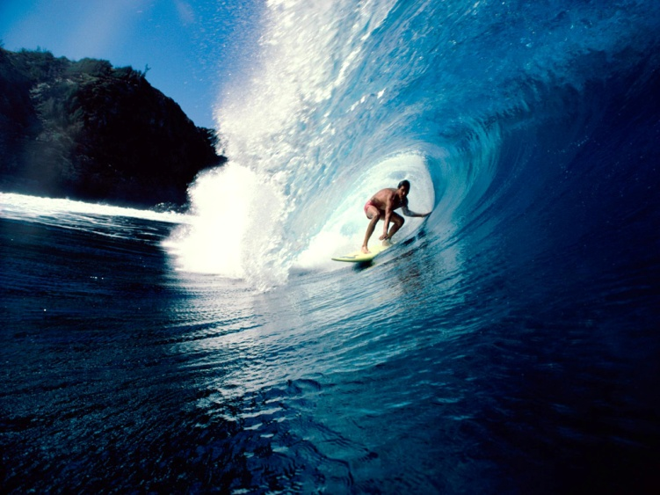
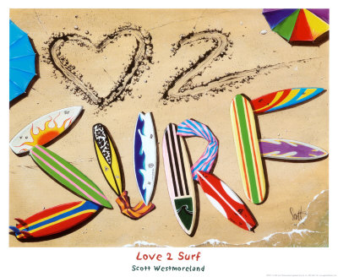
surf- to ride on waves, often on a surfboard
Surfing in El Salvador
Amazing surfer rides the awesome wave
Surf the tunnel

Slide 7
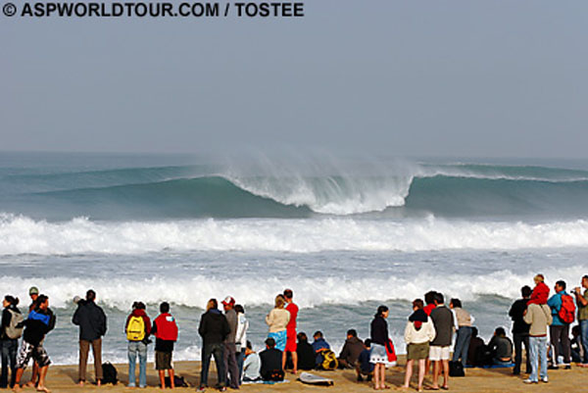
swell- a long wave that moves along without breaking
The swell broke near the coast.
Endless swells

Slide 8
swooped- moved with a sudden, sweeping motion
The bald eagle swooped to catch a fish.

